Slide 1
while

Slide 2
By the end of the discussion, learners should be able to:
Use a while loop to iterate over data

Slide 3
Looping through odd numbers
In the previous discussion, we printed odd numbers in a for loop
// For loop printing out odd numbers
for(let i = 1; i <= 5; i++){
if(i % 2 !== 0){
console.log(i);
}
}
Now lets take a look at the same logic, in a while loop
Notes:
In the last lecture, we wrote this for loop to display all the odd numbers between 0 and 5.
And in this lecture, I'm going to show you how to implement the same logic by using a while loop.

Slide 4
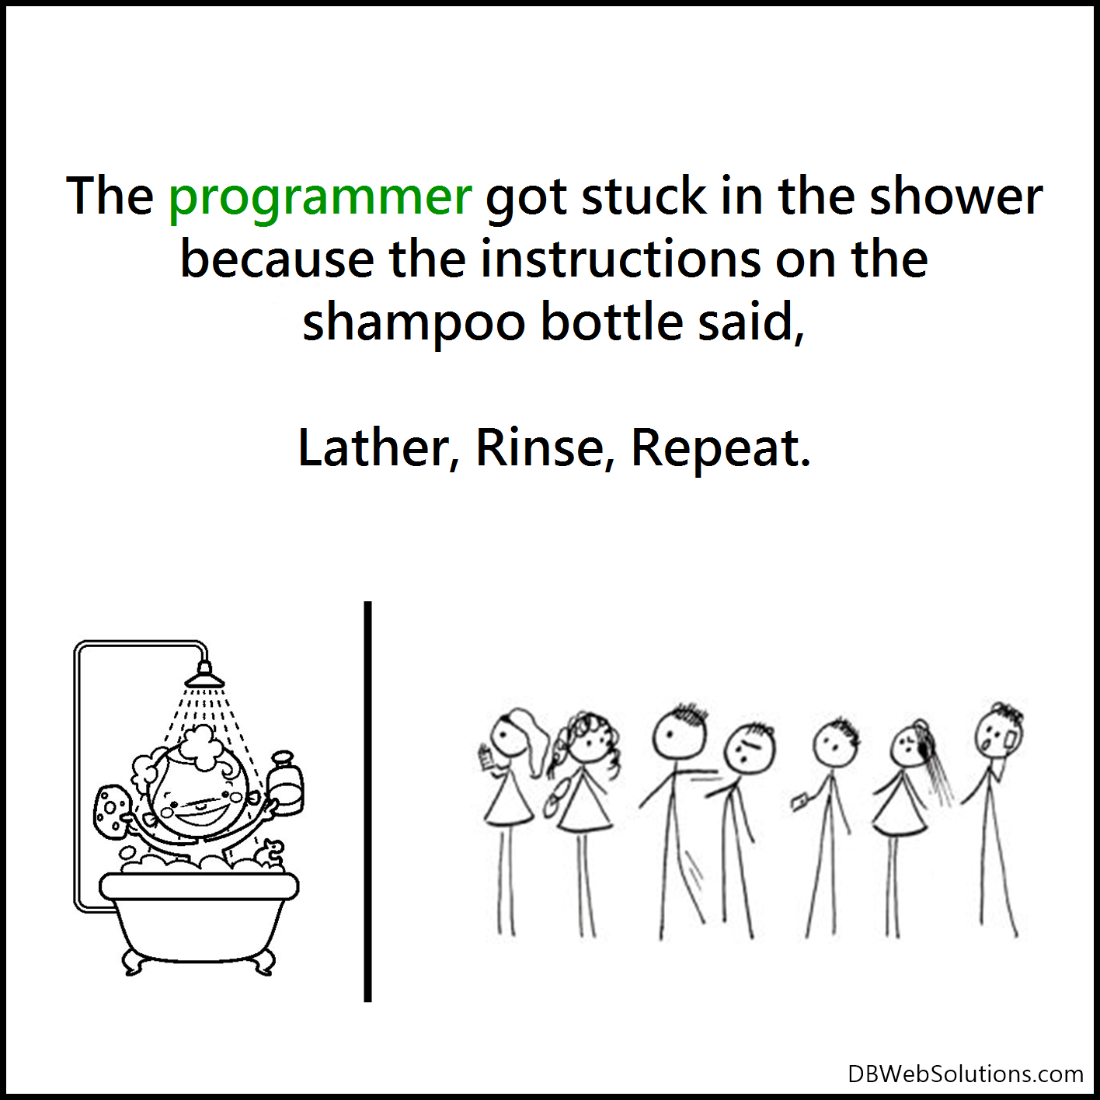
Difference between for and while
One key difference between a while loop and a for loop, is that in for loops the loop variable is part of the loop itself.
But in while loops, you have to declare this variable externally. While loops are pretest loop. The condition is tested first before executing any statement.
Notes:
Now one key difference between a while loop and a for loop is that in for loops the loop variable is part of the loop variable itself.
But in while loops, you have to declare this variable externally.
Let me show you what I mean.

Slide 5
Basic Syntax
while(condition){
//statements here
}
This can be read as “while the condition is true, then execute the following statement”.
Lets go over in more detail with the example.

Slide 6
Basic While Loop to print 1 to 10
<script>
document.write("<h2>Displaying 1-10 using While Loop</h2>")
let i=1;
while (i<11)
{
document.write( i +"<br/>");
i++ ;
}
</script>
The print will be 1….10. If for whatever reason we decide to skip 2 we will change the incrementer to i+=2

Slide 7
Basic Syntax
while(condition){
//statements here
}
This can be read as “while the condition is true, then execute the following statement”.
Lets go over in more detail with the example.

Slide 8
Let us repeat the 7s multiplication exercise
<script>
document.write("<h2>7's Multiplication Table using While Loop</h2>")
let i=1;
let sum =1;
while (i<11)
{
sum= i * 7
document.write(i + " x " + " 7 " + " = " + sum +"<br/>");
i++ ;
}
</script>
So what is the difference from the for loop. Discussion
Notes:
So we start with declaring a variable like i and set it to 0.
Note that this i we have here is different from the i we have in this for loop, because this variable is only meaningful and accessible inside of this for loop. (this is assuming these are in the same file, underneath each other.)
This is called scope, and I'm going to talk about it later in the course, all I want you to know is that these two variables are completely different, even though their names are the same.
Now, we have our loop variable initialized to 0.
Next we add a while statement, in parenthesis we need to add our condition.
What is the condition here? That is i less than or equal to 5.
Next, we need to add our statements.
So what is the statement that we want to repeat?
we want to display the odd numbers, so we add that here as well, and finally,
at the end of this while block we need to increment i.
So this is a direct translation of the for loop on the left into a while loop on the right.
So this is what happens when we execute this code.
Initially I is 0, now in the while loop, first this condition is evaluated, if this condition is true, then the body of the while loop will be executed.
Again, in the next iteration the condition is evaluated again, if it's true, the statements in the while block will be executed, otherwise the while block will terminate.

Slide 9
Let us try implement break in while loops
<script>
document.write("<h1>Counting 1-10</h1>");
let i=0;
while (i<10)
{
document.write(i +"<br/>");
i++;
if (i==6)
{
break;
}
}
</script>
<script>
document.write("<h1>Counting 1-10</h1>");
let i=0;
while (i<10)
{
if (i==6)
{
break;
}
document.write(i +"<br/>");
i++;
}
</script>
Notes:
So we start with declaring a variable like i and set it to 0.
Note that this i we have here is different from the i we have in this for loop, because this variable is only meaningful and accessible inside of this for loop. (this is assuming these are in the same file, underneath each other.)
This is called scope, and I'm going to talk about it later in the course, all I want you to know is that these two variables are completely different, even though their names are the same.
Now, we have our loop variable initialized to 0.
Next we add a while statement, in parenthesis we need to add our condition.
What is the condition here? That is i less than or equal to 5.
Next, we need to add our statements.
So what is the statement that we want to repeat?
we want to display the odd numbers, so we add that here as well, and finally,
at the end of this while block we need to increment i.
So this is a direct translation of the for loop on the left into a while loop on the right.
So this is what happens when we execute this code.
Initially I is 0, now in the while loop, first this condition is evaluated, if this condition is true, then the body of the while loop will be executed.
Again, in the next iteration the condition is evaluated again, if it's true, the statements in the while block will be executed, otherwise the while block will terminate.

Slide 10
Can we use continue in while loops
Yes.
Instead of exiting the loop, sometimes we just want to skip the loop we are currently in. For this we use continue:
let i = 0;
//logs out odd numbers on the console
while(i <= 10){
if(i % 2 === 0){
i++;
continue;
}
console.log(i);
i++;
}
Notes:
So we start with declaring a variable like i and set it to 0.
Note that this i we have here is different from the i we have in this for loop, because this variable is only meaningful and accessible inside of this for loop. (this is assuming these are in the same file, underneath each other.)
This is called scope, and I'm going to talk about it later in the course, all I want you to know is that these two variables are completely different, even though their names are the same.
Now, we have our loop variable initialized to 0.
Next we add a while statement, in parenthesis we need to add our condition.
What is the condition here? That is i less than or equal to 5.
Next, we need to add our statements.
So what is the statement that we want to repeat?
we want to display the odd numbers, so we add that here as well, and finally,
at the end of this while block we need to increment i.
So this is a direct translation of the for loop on the left into a while loop on the right.
So this is what happens when we execute this code.
Initially I is 0, now in the while loop, first this condition is evaluated, if this condition is true, then the body of the while loop will be executed.
Again, in the next iteration the condition is evaluated again, if it's true, the statements in the while block will be executed, otherwise the while block will terminate.

